Slide 1
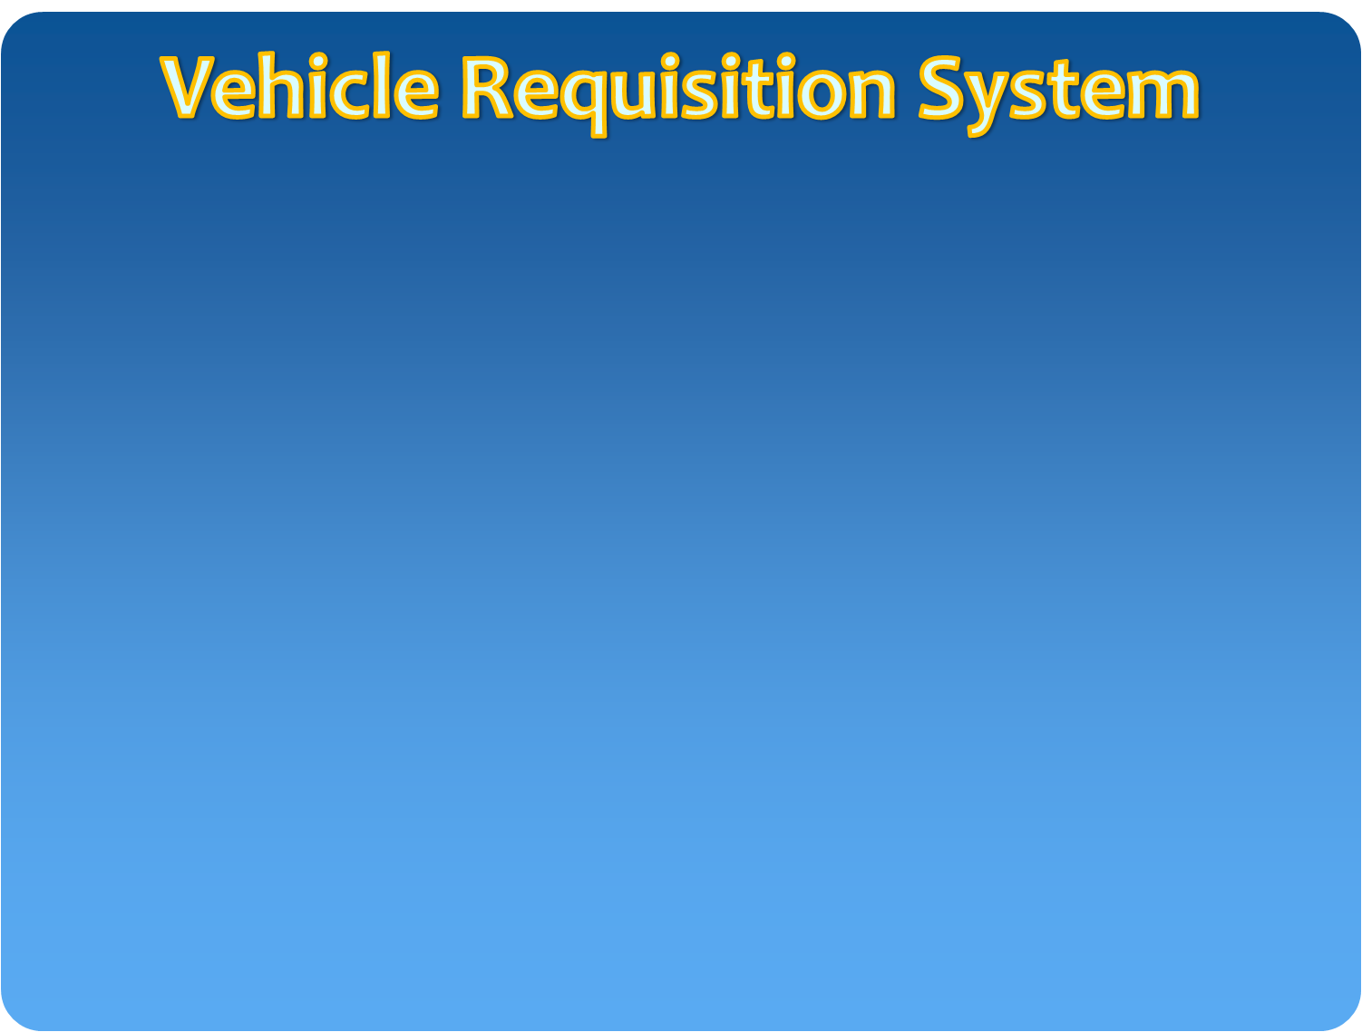
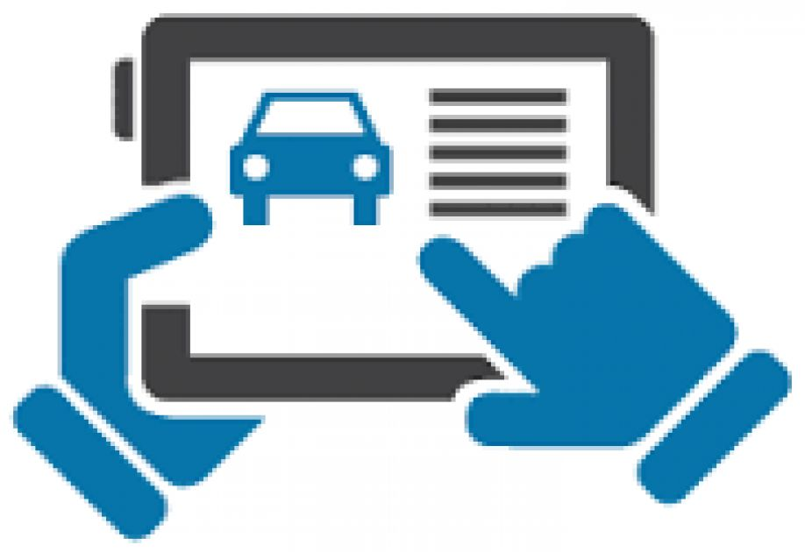

A Software to make the Vehicle Requisition process smarter

Slide 2
Overview: a new software program
A tool for simplifying documents and text
Primarily for people who wants to request for a vehicle requisition
Using MVC platform and computerized automated technologies
It removes the need for paper works
Developed by a team of BKIICT students

Slide 3
How the progam will work
It is a web based application
People request for requisition using their web browser through internet
A controller will get the request through internet and will assign a vehicle against the request
Controllers action will send as a notification to the requester and then driver of assigned vehicle

Slide 4
Objectives:
Issuance of requisition letters for vehicles.
Generation of log book.
Generation of payment calculation chart and release order.
Information about payment / POL to vehicle owners.
Capturing of vehicle details with address, Mobile number and bank details of Owner & Driver.

Slide 5
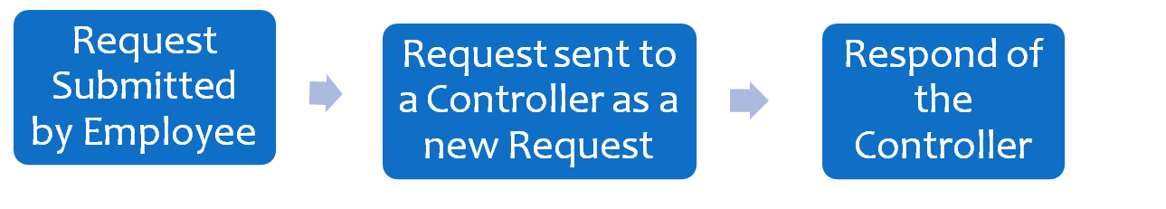
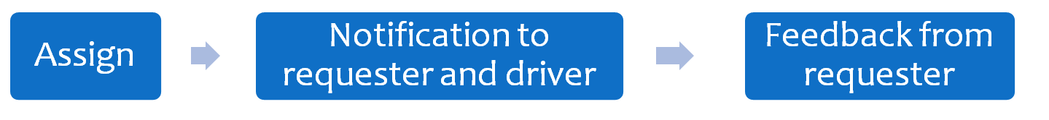

Process flow

Slide 6
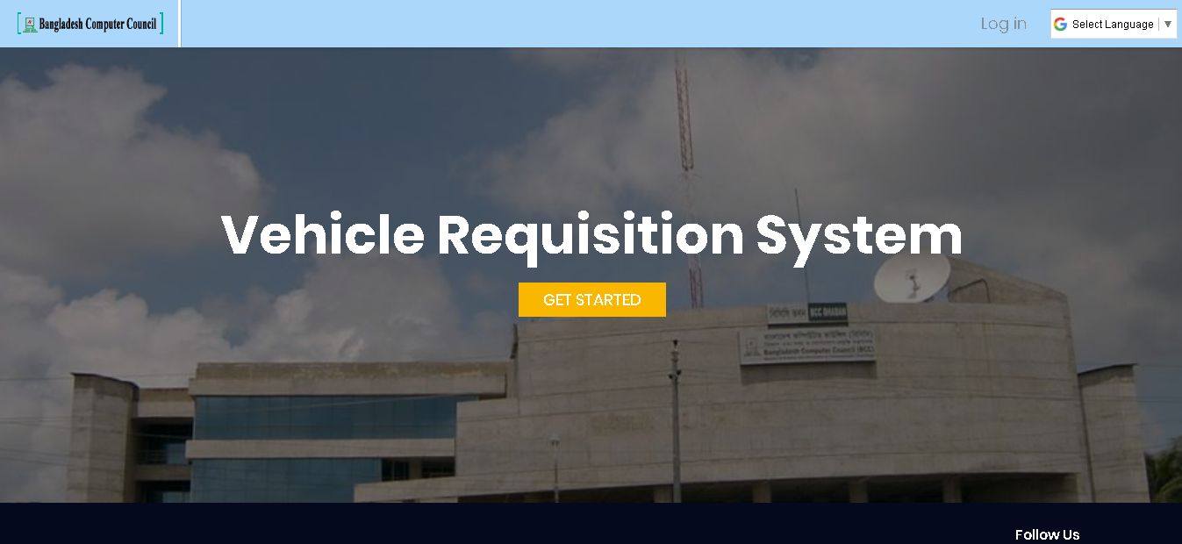
Login-page

Slide 7
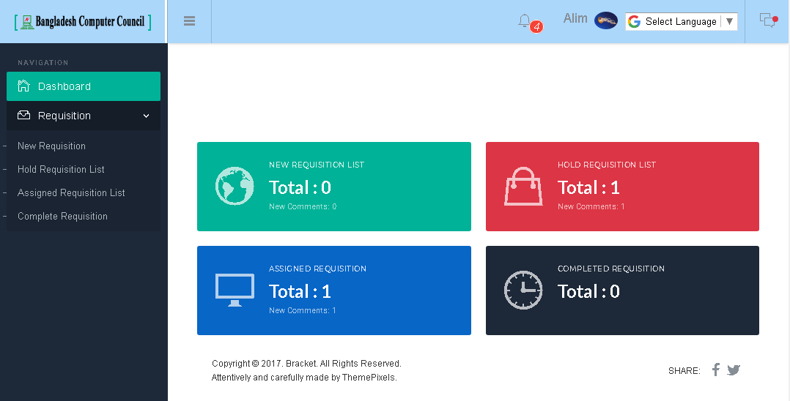
Employee Dash Board

Slide 8
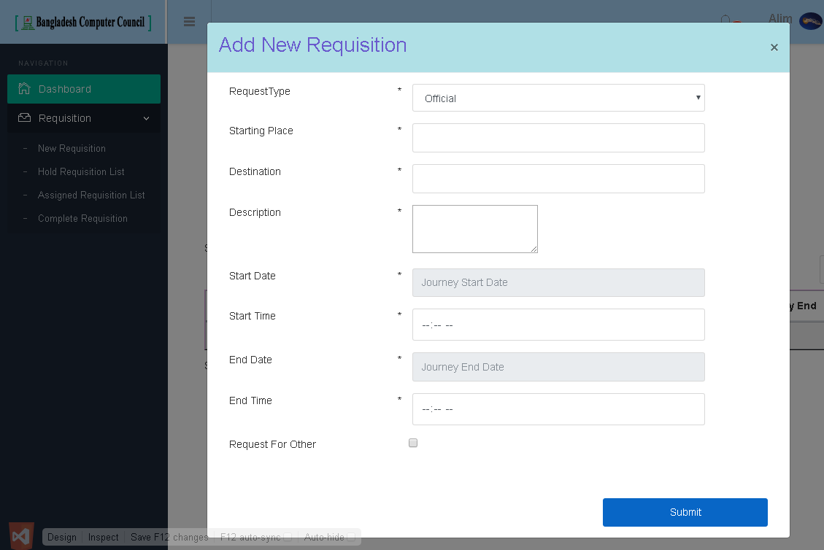
Requisition entry

Slide 9
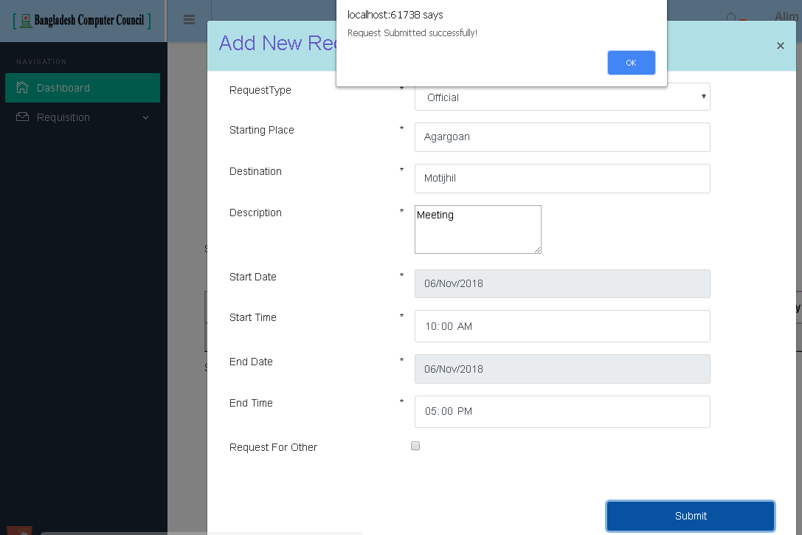
Requisition entry

Slide 10
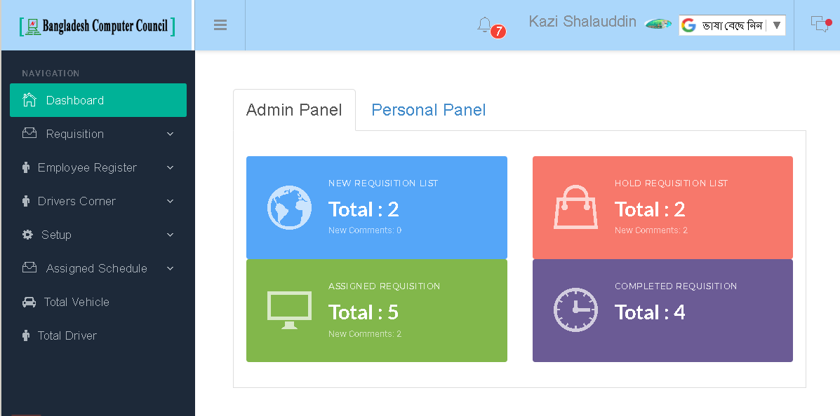
Controller Dash Board

Slide 11
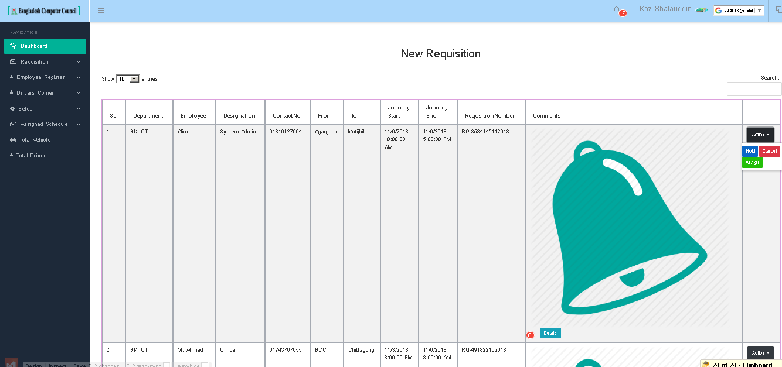
Waiting requests page

Slide 12
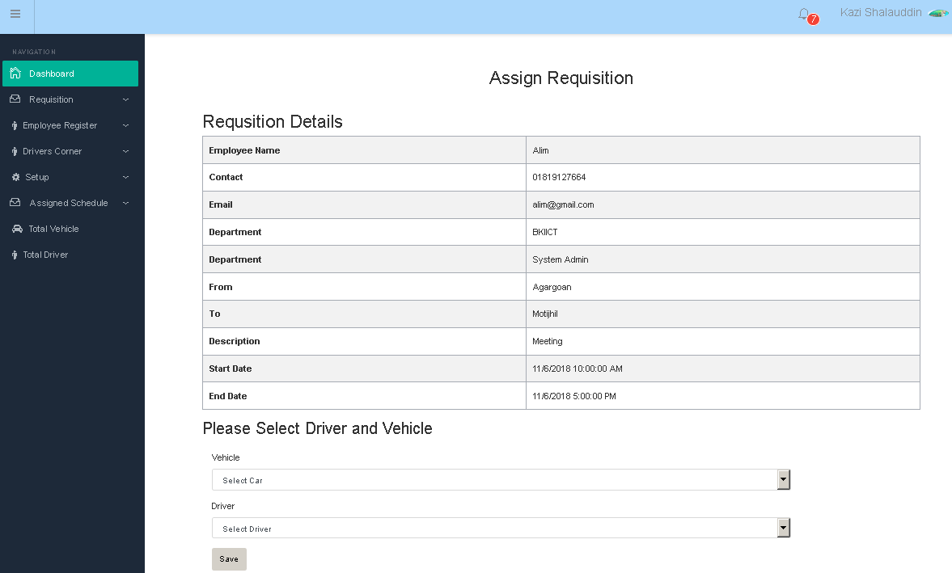
Requisition assigning panel

Slide 13
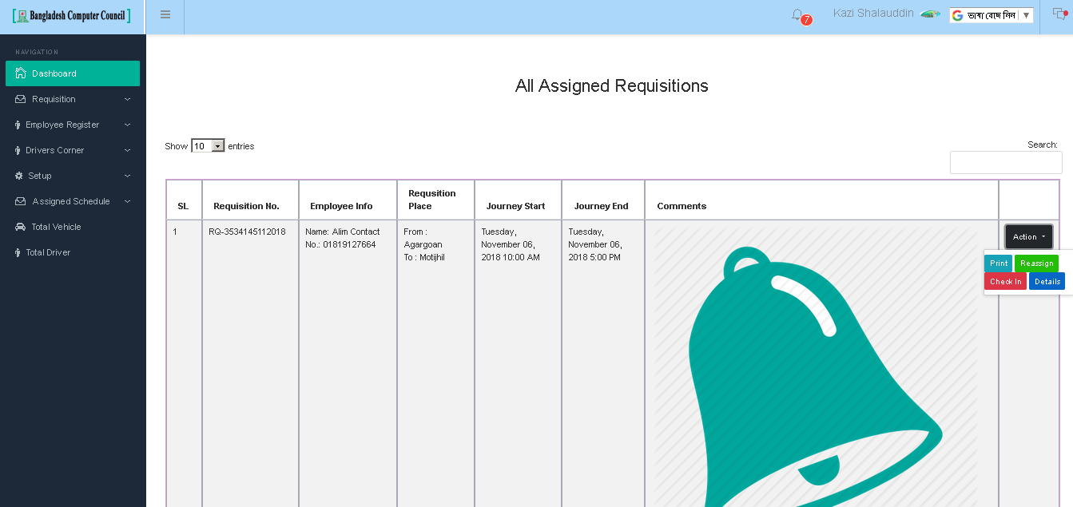
Assigned requisitions list

Slide 14
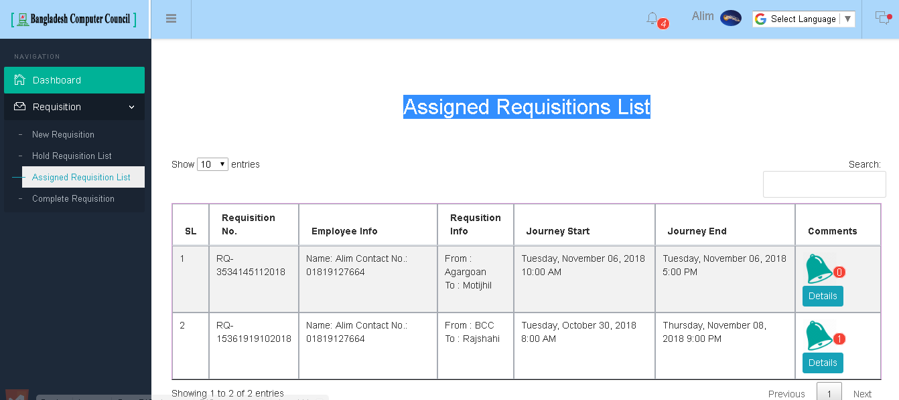
Employee’s Assigned Requisitions List

Slide 15
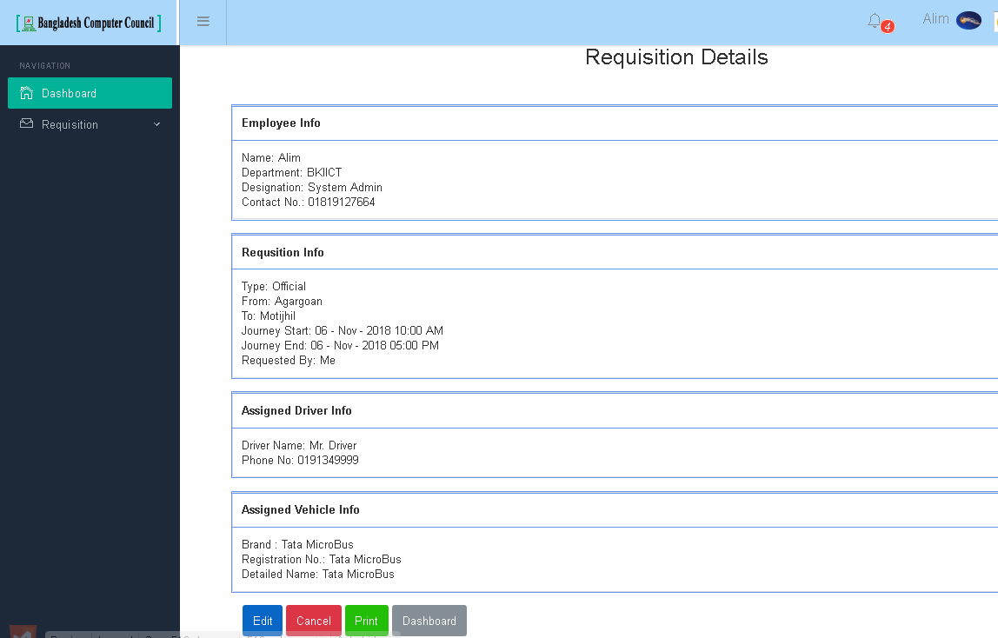
Employee’s Assigned Requisitions List

Slide 16
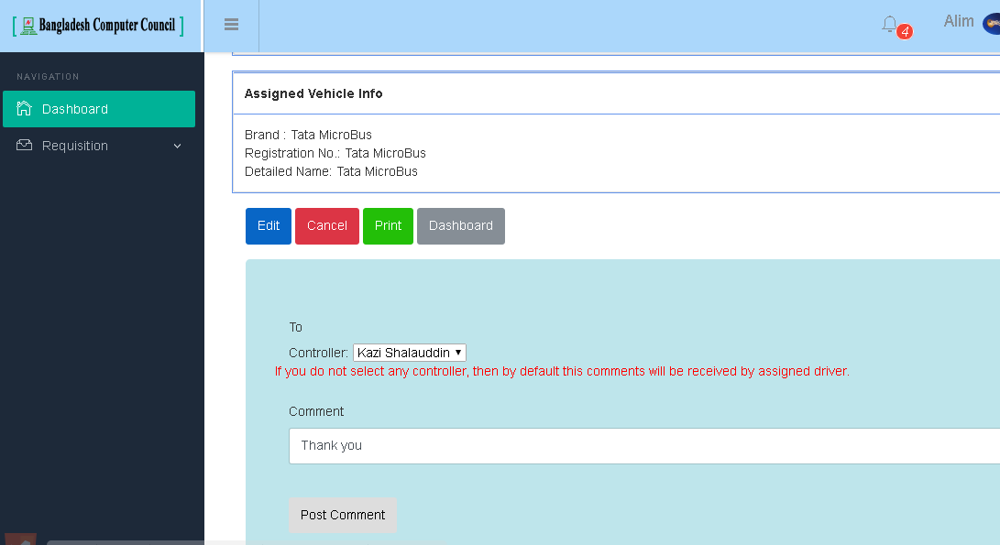
Employee’s feedback

Slide 17
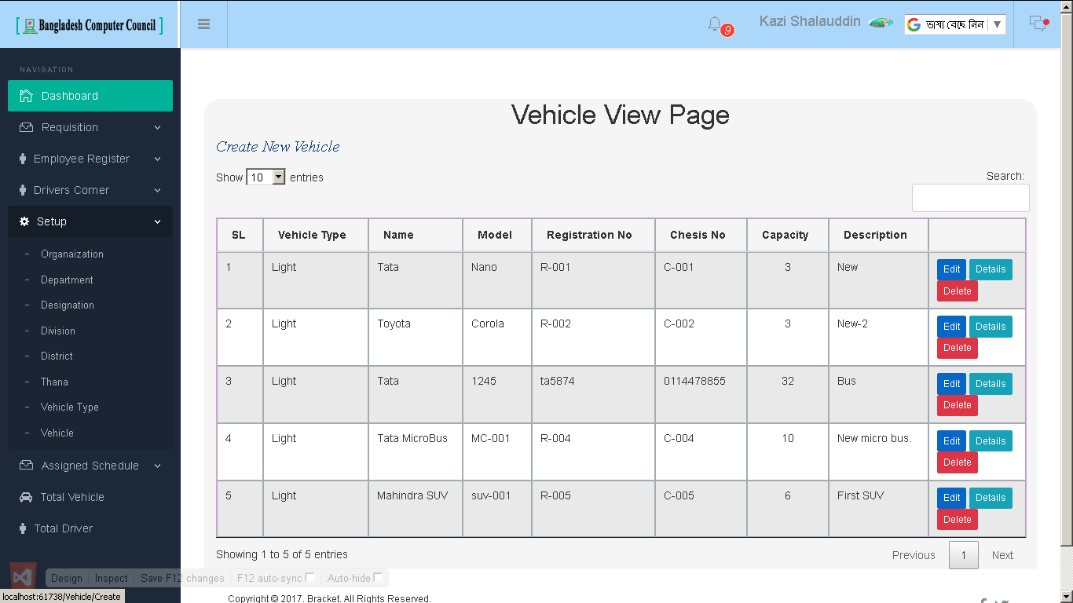
Setup pages

